Slide 1
* Topic *
Website
www
http/https
Client server
Domain
Host
Hosting
FTP = > File Transfer Protocol
Path
Extension
Editor / vscode
URL – URI / URN
Address bar
Title bar

Slide 2
Definition of website
a place connected to the Internet, where a company, organization, etc. puts information that can be found on the World Wide Web. ____________________________________________________________
Website example
example - javatpoint.com, google.com, youtube.com. ________________________________________________
www
Full from of www :- “ world wide web ____________________________________________________ __________________ Definition of www___________________
all the public websites or pages that users can access on their
local computers and other devices through the internet.
________________________________________________________________________________________________________example____________________________________
www.learncomputerscienceonline.com
www.youvaworld.com

Slide 3
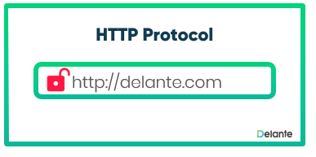

Meaning of http & https
http :-
“ Hypertext Transfer Protoco ”
https
“ Hypertext Transfer Protocol Secure ”
___________________________________________________________________
*definition of http & https*
http :- “ The primary function of HTTP is to establish a connection with the server and send HTML pages back to the user's browser.
__________*___________*__________*__________*____________*__________*__________*___________
https :- “HyperText Transfer Protocol Secure, enables protected communication over the computer network.”
_________*___________*__________*_____________*_____________*_____________*____________*______________

Slide 4
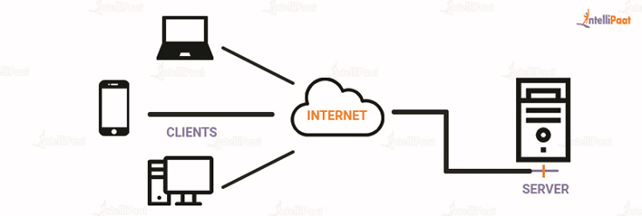
* Client server *
denoting a computer system in which a central server provides data to a number of networked workstations.
________________________________________________________________
* Exa. =

Slide 5
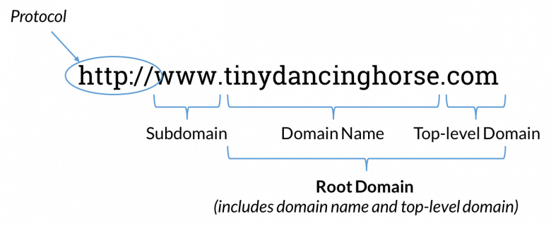
*DOMAIN*
a particular field of thought, activity, or interest, especially one over which someone has control, influence, or rights.
__________________________________________________________
example
Exa.=

Slide 6
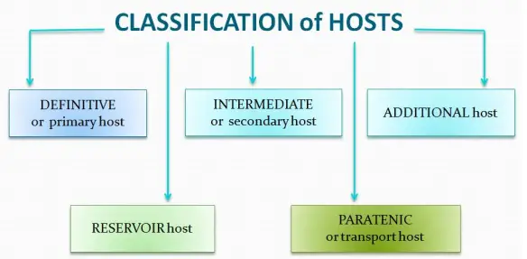
* HOST *
a person who talks to guests on a program (such as a radio or television show or a podcast)
___________________________________________________________________________
Example:-

Slide 7
FTP = > File transfer protocol
* HOSTING *
A web hosting is a generic term used to refer to a type of server that hosts websites and/or related data, applications, and services.
It is a service that allows users to publish a website on the internet.
Example :-
When you have a company that has space on servers and people buy space to store their websites so they can appear on the Internet,
____________________________________________________________________
FTP is a client-server protocol that relies on two communications channels between the client and server: a command channel for controlling the conversation and a data channel for transmitting file content.

Slide 8
* Extension *
* PATH *
a route or track between one place and another, or the direction in which something is moving.
Example :-
home/sally/statusReport is an absolute path.
________________________________________________________________________
An extension, in computer operating systems, is a piece of software that enhances or “extends” the capabilities of a programming language or other applications. An extension adds extra features to an already working standalone application. Usually an extension itself is not independently functional and needs other software with which to work

Slide 9
Editor / vscode
Editor :- a computer program that permits the user to create or modify data (such as text or graphics) especially on a display screen
__________________________________________________________
vscode :- “a free editor that helps the programmer write code, helps in debugging, and corrects the code using the intelli-sense method”. ________________________________________________________
URL-URI/URN
URL :- “ Uniform Resource Locator ” ________________________________________________________
URI :- “ Uniform Resource Identifier ” _________________________________________________________________
URN :- “ Uniform Resource Name ” ________________________________________________________

Slide 10
definition
URL :- “a unique identifier used to locate a resource on the Internet”. __________________________________________________________________
URI :- “URI identifies a resource and differentiates it from others by using a name, location, or both”. ________________________________________________________
URN :- “identifies every resource on the internet, regardless of its form, such as a website or email”.
________________________________________________________________________________
Example :-
URL :- “http://example.com”
URI :- “foo://example.com:8042/over/there?name=ferret#nose”
URN :- “urn:isbn:1234567890”

Slide 11
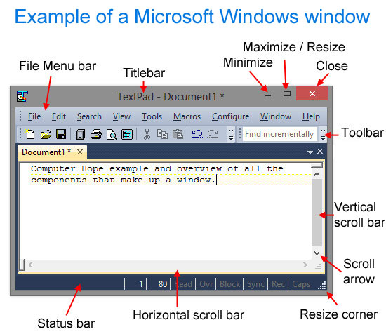
Address bar
a text box in a web browser displaying the address of the web page that is currently being viewed.
In short, the field called the address bar serves to issue the command to the Internet browser on which page you want to visit. The address bar example is
Example :- http://www.akademijaoxford.com/ or http://www.srednjaskola svarhangel.edu.rs/ .
_________________________________________________________
Title bar
It displays the title of the software, name of the current document or file, or other text identifying the contents of that window. For example, in the picture below, the title bar displays the program name "TextPad" and the document name "Document1" that is currently being edited
_________________________________________________________________________

